Slide 1
Ethnic differences in aortic pulse wave velocity occur in the descending aorta independent of blood pressure and may be related to vitamin D
MR Rezai, SG Anderson, N Sattar, J Finn, F Wu & JK Cruickshank*
Cardiovascular & Endocrine Sciences
University of Manchester & Glasgow Royal Infirmary
*Now @ King’s College & St Thomas’ Hospital, London

Slide 2
Background
Increasing evidence suggests that vitamin D may have an important role in modifying risk of cardiometabolic outcomes.
Cross-sectional & prospective studies (and meta-analyses of these) have shown an independent inverse association between blood 25-OH vitamin D and CVD risk factors including BP, diabetes and dyslipidemia

Slide 3
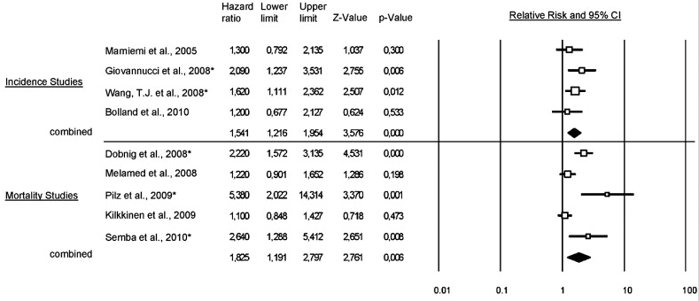
Meta-analysis of CVD incidence and mortality
About 50% increased risk of CVD incidence and mortality in the lowest compared to the highest categories of vitamin D (pooled HR = 1.54 [1.22–1.95])
Grandi et al. 2010. Prev Med. 51(3-4):228-33

Slide 4
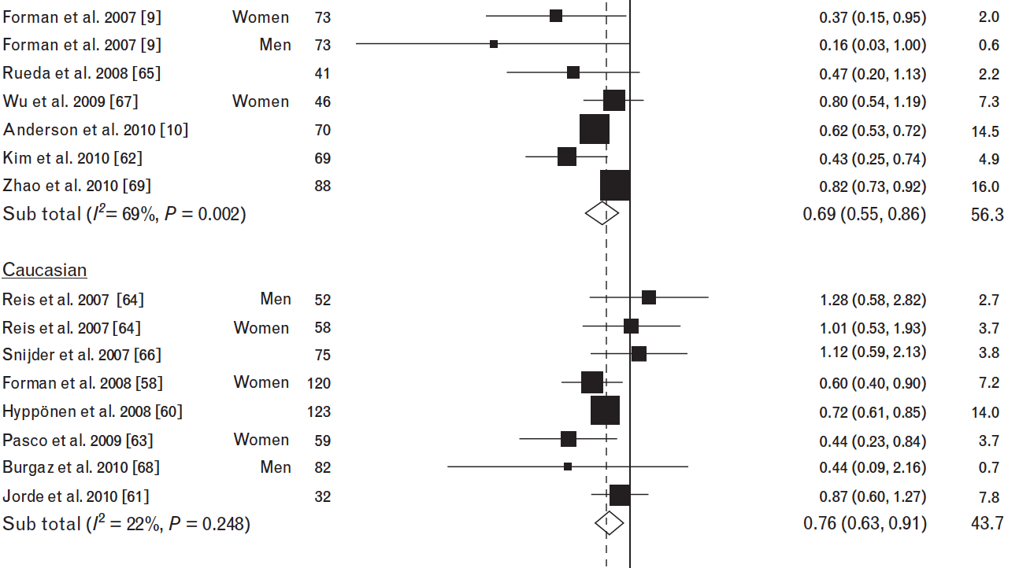
Reduced odds (24%) of hypertension for the highest vs. the lowest category of vitamin D
Burgaz et al 2011. Journal of Hypertension. 29(4):636-45

Slide 5
Most of Northern Europe vitamin D deplete or deficient through winter - and beyond
Setting - North West Britain (2009-2010)
Population – 724 General Medicine OPD clinic attendees assessed for vitamin D status
Vitamin D deficiency - 75% with vit D <40 ng/ml **
Vitamin D deplete - 23% <20 ng/ml#; 33% were South Asian
10% & 15% overtly vitamin D deficient## and South Asian
**’recommended’ #’deplete’ ## <10ng/ml
Data courtesy of Prof R Malik

Slide 6
Study Aims & Hypotheses
To Calibrate the Arteriograph against MR
To examine the role of vitamin D on arterial stiffness - & its relation to ethnic differences in CVD
Hypotheses:
Vitamin D would correlate closely with PWV, in relation to vascular risk
People with melanised skin (eg: South Asian & Caribbean-origin), for given BP levels, have stiffer arteries in line with Vitamin D levels, independent of other Risk Factors

Slide 7
Study participants
198 men aged 40 to 80 years of AfC, SA, and European origin previously recruited to the European Male Ageing Study*.
The participants had to be free of severe chronic or acute disease
*N Engl J Med 2010; 363:123-135

Slide 8
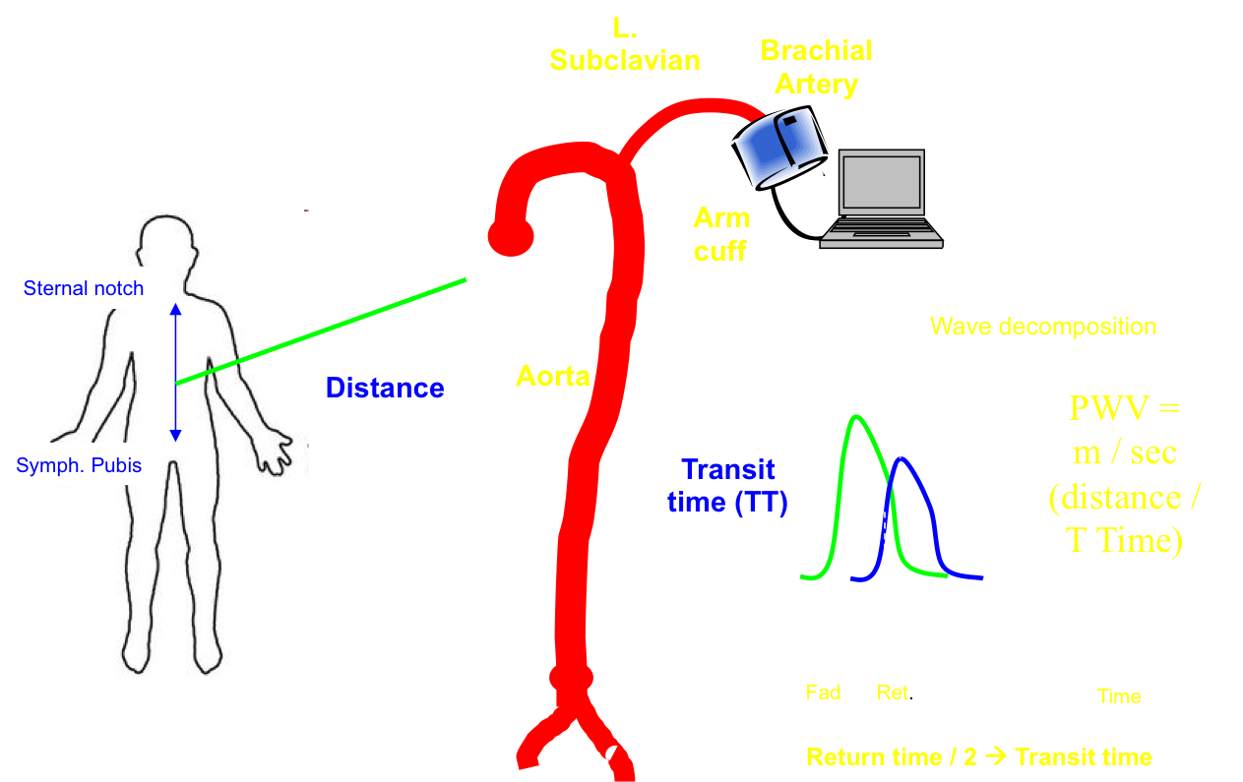
The Arteriograph device was used to measure arterial stiffness indices, including total aPWV
Measurements were performed ≥2 times on the left arm after ≥5 minutes of rest supine after BP measurement.
The difference in time between the beginning of the 1st wave and 2nd (reflected wave) is divided into the distance from sternal notch to pubic symphysis.

Slide 9
Arteriograph aPWV estimates calibrated with MRI-derived Aortic Lengths
Comparison of MR-derived total aortic lengths indicated an over estimate of real aortic path using external landmarks.
Mean difference 7cms (SD 2.8)
Transit times similar
Consequently, we recalculated Arteriograph aPWV using transit times measured by device and length of aortic path estimated by a regression model from MR

Slide 10
Study Characteristics by ethnicity
S
Asian
Af
-
C
’
bean
European
(
n=65)
(n=64)
(n=62)
Age (yr)
55±10
54±10
56±8
SBP
124±15
<
129±16
126±13
DBP (mmHg)
78±10
<
82±11
81±8
PP
46±9
48±10
45±7
HR (bpm)
68±11
>
64±8
>
61±8
BMI
27±3
28±5
27±4
Arterial
Stiffness
PWV (m/s)
8.1±1.5
>
7.2±1.2
<
7.8±1.4
central BP
125±19
127±20
124±12

Slide 11
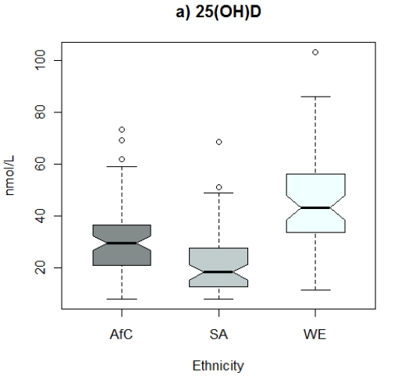
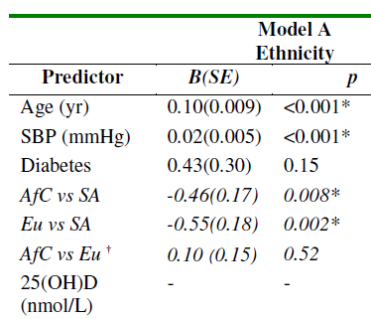
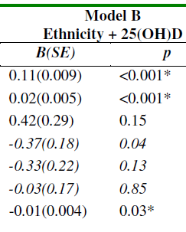
Vitamin D levels by Ethnic group & regression results for PWV
Ethnic effect
diminished / absent
P<0.01 lower

Slide 12
MRI sub-study
Randomly selected MRI study participants (n=47) consisting of 16 Caribbean, 13 Pakistani, and 18 European men

Slide 13
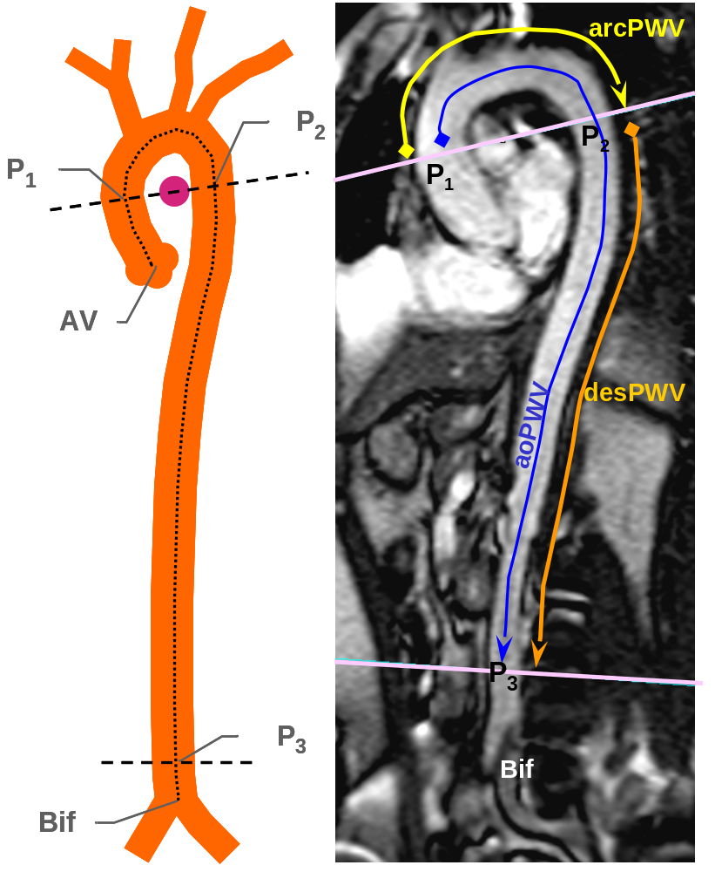
Regional MR PWV derived from sagittal views
(3 aortic paths - P₁P₂, P₂P₃, and P₁P₃)
The MR protocol for PWV measurement used a 1.5-T Philips Intera scanner to acquire 2 consecutive transverse images:
  One from aortic arch at level of pulmonary artery
  The other 2cm above the aortic bifurcation.

Slide 14
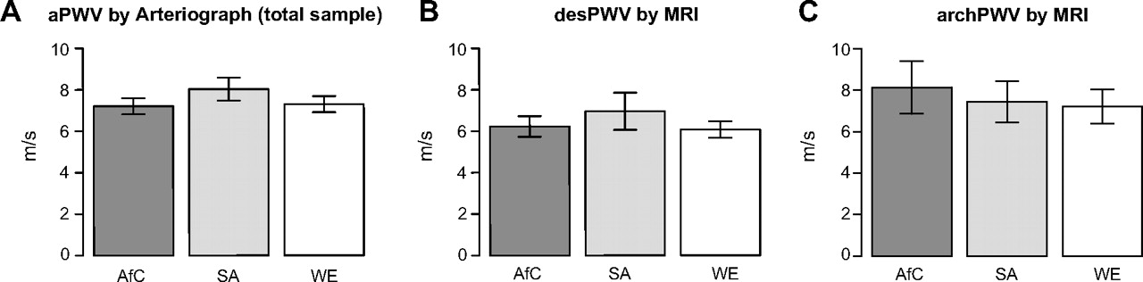
Regional PWV profiles across ethnicity.
Age-SBP adjusted mean desPWV_{MR} in SAs was 0.7 m/s (0.3 m/s) and 0.8 m/s (0.3 m/s) greater than in AfCs and Europeans, respectively

Slide 15
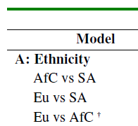
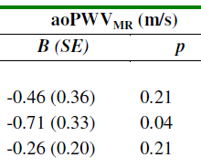
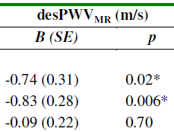
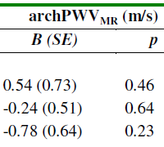
Are the larger sample PWV data by Arteriograph replicated by MR?
Hypertension – Aug 2011

Slide 16
Summary
Consistent with CVD risk among UK Caribbean, South Asian and Europeans…
  SA men had higher (descending) aPWV, despite slightly lower distending BPs, using a single point arm based device (calibrated via MR)
  These changes were confirmed on an MR imaged sub-sample
  Plasma vitamin D levels are related to aPWV & account for much of the ethnic difference in aPWV

Slide 17
Thank You

Slide 18
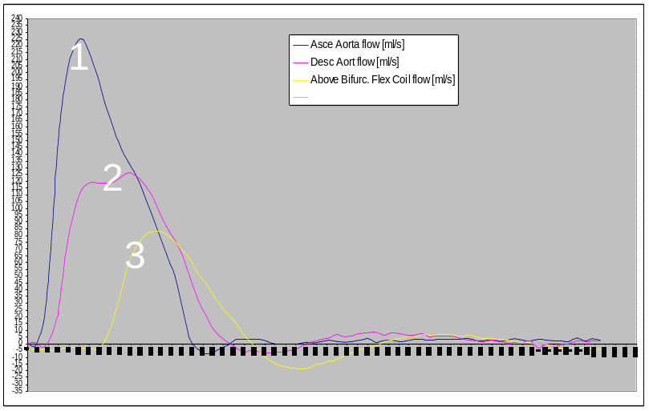
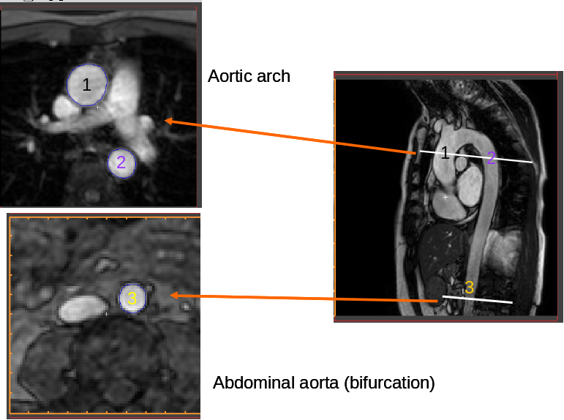
Arrival times of the aortic pulse waves were computed from the
3 flow-time curves recorded at the 3 points: P₁, P₂, and P₃
Flow curves from 3 sections
(Transit time derived from P1P2, P2P3 and P1P3)
10% of the slope of the flow wave from each site

Slide 19
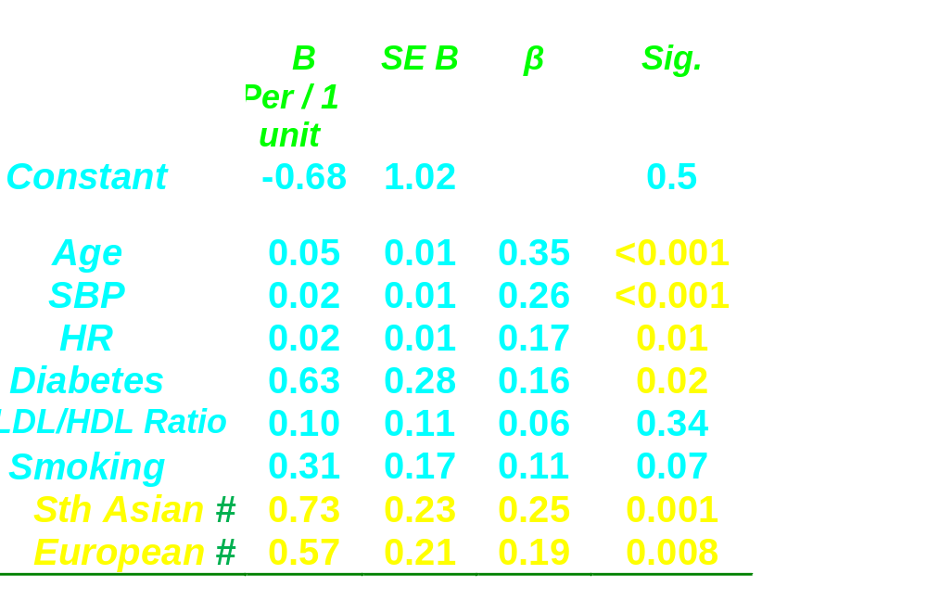
Multiple regression model: risk factors related to aortic stiffness = Pulse Wave Velocity (R²=0.36).
# vs
Af C’beans

Slide 20
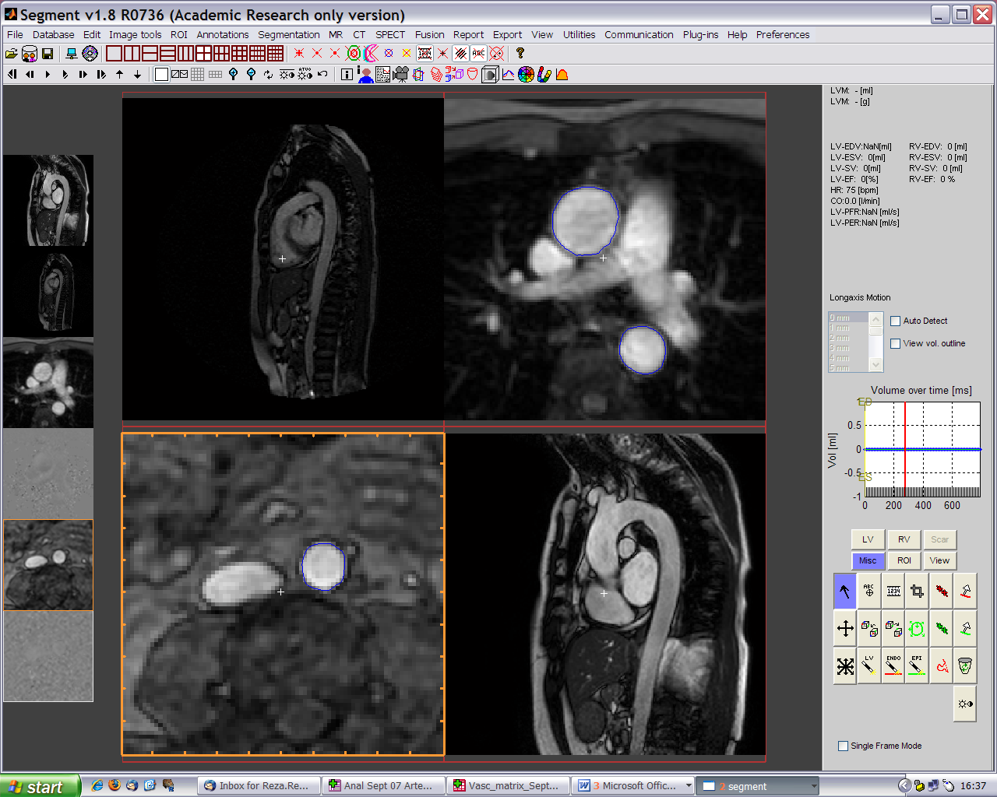
Making PWV measures by MRI
1
Aortic arch
2
1
2
3
3
Abdominal aorta (bifurcation)

